Slide 2
Create, Share, and Consume Great Maps With ArcGIS Online
O’Reilly - Where 2012
Jeff Archer
Esri, Inc.

Slide 3
Creating and Sharing Great Maps
ArcGIS Online – nickel tour
Build a map!
Esri developer landscape
Consume the map in custom apps
  iOS, Android, JavaScript, etc.

Slide 4
ArcGIS Online

Slide 5
ArcGIS Online
Author maps and build apps
Serve your own data with hosted services
  No software or hardware to set up or install
Ready to use content and services
Includes web and device APIs
  Browsers, tablets, phones, desktops
  Configurable viewers and app templates

Slide 6
ArcGIS Online
Easy administration
  Users
  Content
  Security
Share and collaborate with groups feature
Use services to build web maps and apps

Slide 7
Hosted Services
Publish maps and data with no software
Publish data as tiles or features
  Tile generator service included
Drag and drop data to create a service
Feature services = editing
Your data is your data
No ads

Slide 8
ArcGIS Online
Organizational and enterprise plans
  Named users and credits
Available as an on-premise software product
  Portal for ArcGIS

Slide 9
Build a Map!

Slide 10
Make your own maps
Choose a base map
Pick some cool layers
  Or upload your own
Add a bit of geo-savvy
Share

Slide 11
Developer Landscape

Slide 12
Developing With ArcGIS Online
Build web, device, and desktop apps
  Use web maps to organize content
Use ArcGIS Online as your advanced starting point
  Configure maps and services
    Use web maps to organize and model app content
    Easier to build a map than write code
  Upload and organize content
    Hosted services, groups, access control

Slide 13
ArcGIS Online Information Model
Portal
User
Group
Item
Web Map
Layer
Feature Service
Tile Service
Dynamic Map Service
Image Service
WMS Service
KML
Application
Web
Mobile
Desktop
Tool
Geocode
Geoprocessing
Datafile
Layer Package
Shapefile
CSV

Slide 14
ArcGIS Online – Application Development
Web APIs for browser-based apps
  Javascript, Silverlight and Flex
  Support mobile browsers and other mobile options like AIR Mobile and PhoneGap
ArcGIS Runtime APIs for devices
  iOS, Android, Windows Phone, WPF, Java

Slide 15
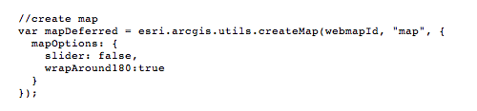
JavaScript API Map Creation
I mean, it’s super easy…

Slide 16
ArcGIS Online – Application Development
Core of the app can be generated as a web map
Configurable apps and templates if writing code makes you cold and frightened
  New(ish) application builders
    Flex, Silverlight

Slide 17
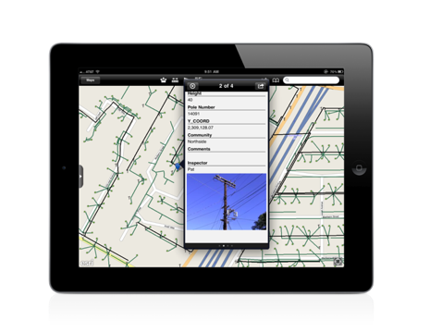
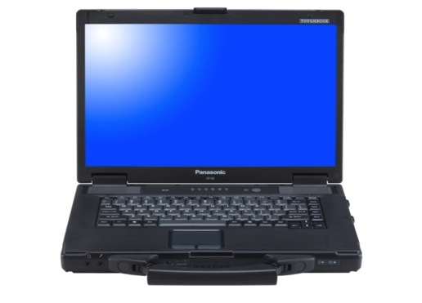
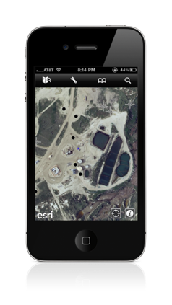
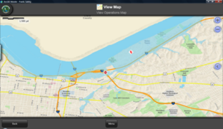
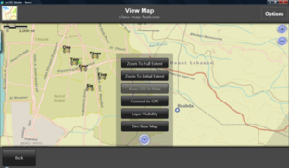
Application Development
A New Paradigm
Microsoft Style - Desktop Applications
  Desktop apps with menus, toolbars and ribbons
Google Style – Web
  Browser based, always connected
Apple Style – Native Applications
  Focused applications
  Often part of an eco-system of apps
  Connected – Powered By ArcGIS Online
  Disconnected
  Built to exploit the device

Slide 18
The Runtime
Every Platform Requires a Runtime
ArcGIS Runtime
  Designed to support your application development
  ArcGIS Online services
  Local data and processes
  Runs on the platforms you need

Slide 19
The ArcGIS Runtime Architecture
Runtime Core
  C++
  Small
  High performance
Client APIs Expose Functionality to Developers
  DotNet
  Java
  Objective C
Client
APIs
C++
Core

Slide 20





ArcGIS Runtime
The Runtime is Technology
  Developers build applications with SDKs
  Users run Applications
Fully Integrated Inside the ArcGIS System
Online Services Accessible with the Runtime
Maps, Data and Tools Managed with ArcGIS Desktop Shared with the Runtime

Slide 21

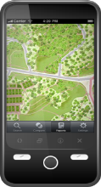
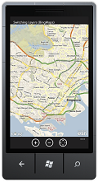
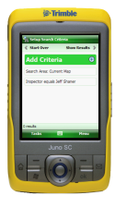
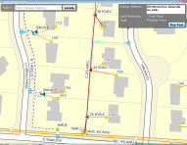

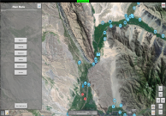

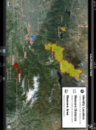
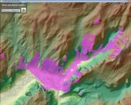
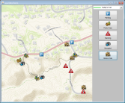
Native Application Development Platforms
iOS
Android
Windows Phone
Windows Mobile
Windows
Linux
Mobile
Devices
Desktop
Each Platform Has
  A runtime
  API + SDK
  Applications

Slide 22
Create some cool stuff!

Slide 23
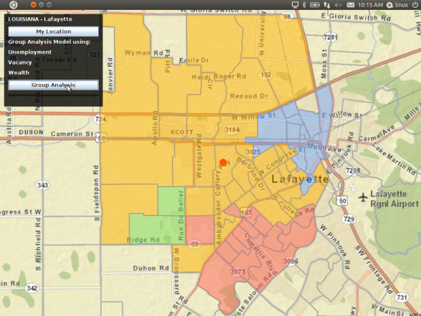
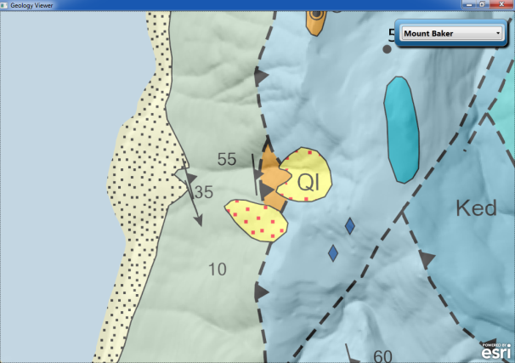
ArcGIS Runtime on the Desktop
New Architecture for Desktop Developers
Windows and Linux
32 and 64 bit
Scalable
Asynchronous Programming Model
Easy to Deploy

Slide 24
New Supported Platforms
Windows 8
  The next version of Windows
    Your Windows 7 applications just work
  Metro Style
    Touch user experience
  ARM Processor Support

Slide 25
New Supported Platforms
Mac OSX
  Cocoa API for Mac app developers
  A first for Esri
  Under development
  Release in the Fall
  Sign up for beta and give us your feedback!

Slide 26
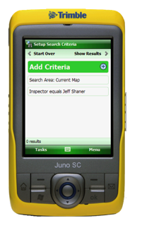
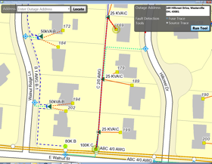

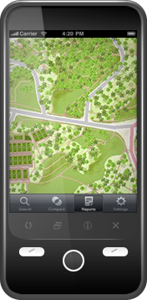
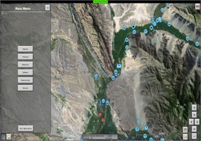

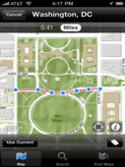
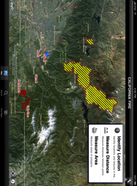
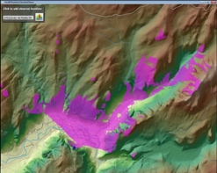
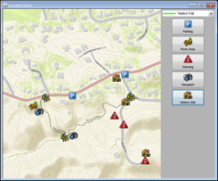
Native Runtime SDKs
Windows Mobile
Windows
Linux
iOS
Android
Windows Phone
Runtime SDK
.NET CF
Runtime SDK
WPF, Java
Runtime SDK
Java, Qt
Runtime SDK
Objective C
Runtime SDK
Java
Runtime SDK
Silverlight
Rugged and Embedded Devices
Smartphones and Tablets

Slide 27
Easy to Start
Free to sign up!!
Free to develop!!
A lot of features free for both commercial and non-commercial apps!!
No ads!!
Credit-based system!!

Slide 28
Licensing Q&A
Q. Is there are charge for building and deploying mobile or web applications using any of the Esri basemaps and layers?
A. No, use of APIs, SDKs, and deployment both commercially and non-commercially is free.
Q. How are costs applied?
A. Costs apply when you use geoservices and/or cloud storage and hosting services, and for delivery bandwidth. Costs are based on credits, which can be applied towards whatever you want – storage, hosting, or bandwidth.

Slide 29
Licensing Q&A
Q. How much does it cost to begin development?
A. Just sign up and you can start development for free using your starter (trial) account. When you are ready to deploy, your subscription includes credits, which can be applied towards whatever you want – Geoservices, storage, hosting, or bandwidth. Cost – Stay tuned ☺
Q. What’s a credit, and how much of the above does it cover?
A. Stay tuned ☺

Slide 30
Thanks!!
Jeff Archer jarcher@esri.com
Twitter - @vee_dubb

Slide 31


Medical services

Slide 32
Geomedicine—Working definitions
Academic approach
Information integration approach
Medical geography
Population health

Slide 33

Future of Geomedicine
Place histories common
Product use histories common
Personal — epidemiology
Rise of new sub-specialties
Unprecedented patient data flows
Increasing geographical transparency

Slide 34
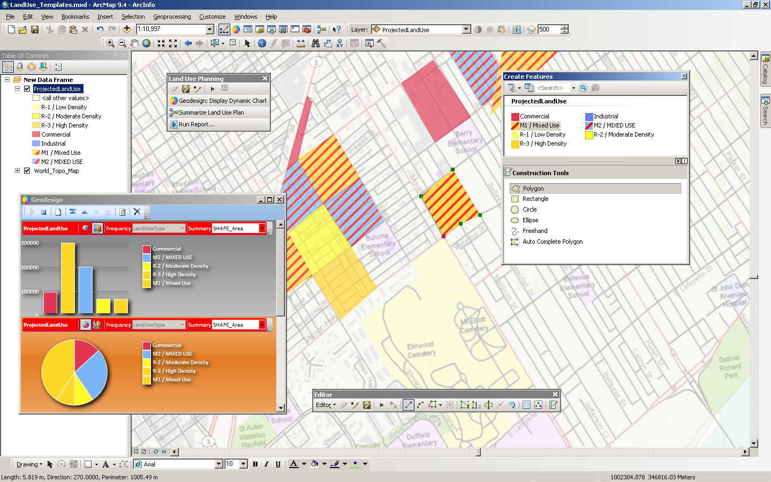
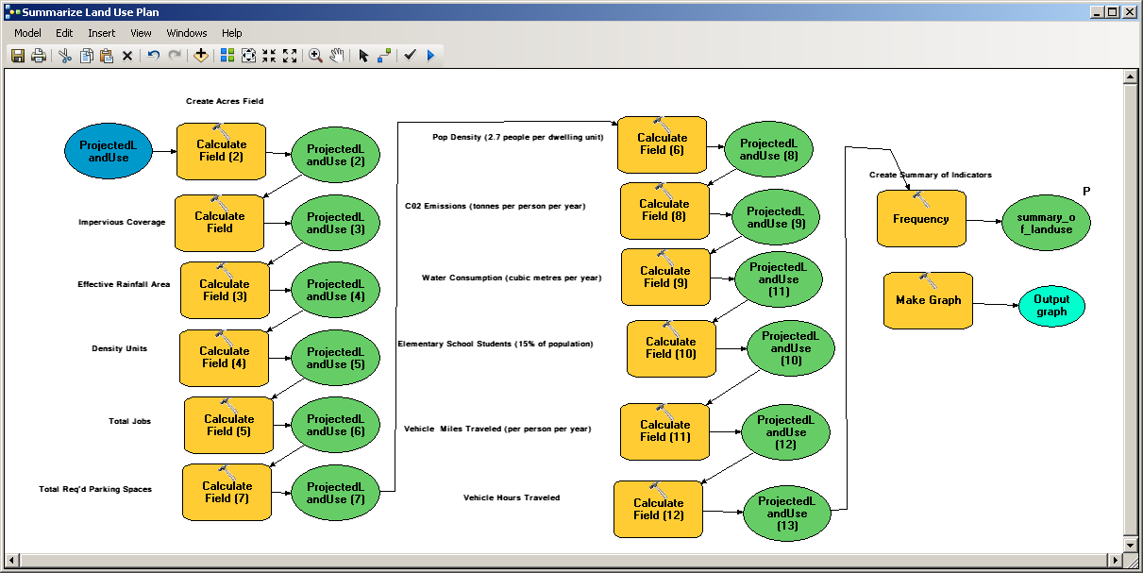
Sample Screen Shots Layout (preferred)
Notes:
How to put a box behind a screen shot.
Copy and paste screen shot box from page 21
Resize to fit around your screen shot
Send box behind a sceen shot or move screen shot to front (right-click)
Select both screen shot and a box behind it, then select “Align Center” and “Align Middle”
Group with screen shot (right-click)
Option: adding reflection by selecting a group-object, set Transpency to 80%, Size: 30%, and Distance: 1 pt

Slide 35



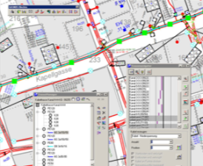
Sample Screen Shots Layout
Underground Utilities
Utility Network
University
Texas
Pennsylvania
Germany

Slide 36
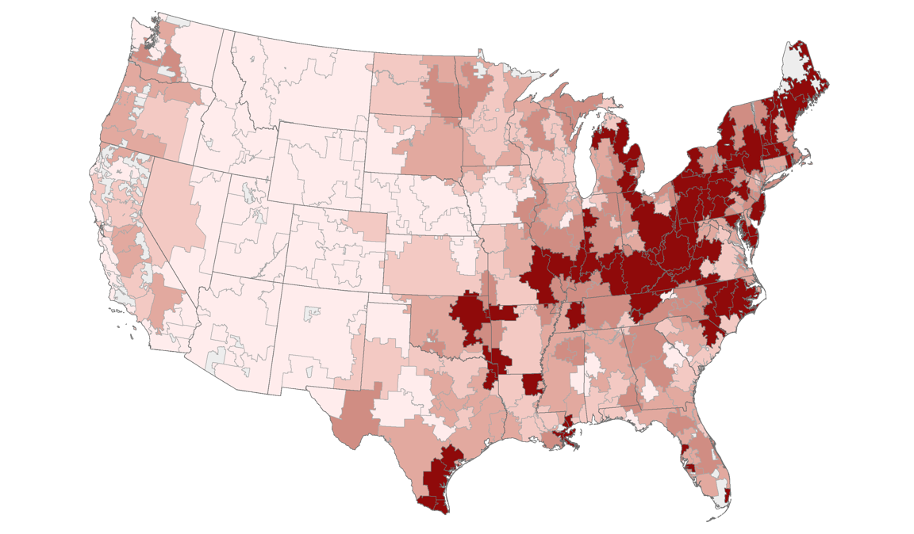
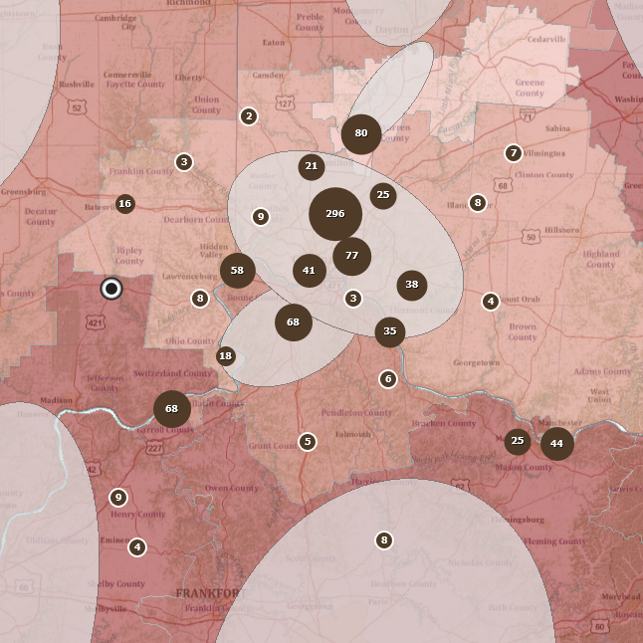
High death rate location

Slide 37

Forestry GIS
Solution

Slide 38
“PowerPoint slides are like children: No matter how ugly they are, you’ll think they’re beautiful if they’re yours.”
Scott Adams

Slide 39


What experts are now saying…
Environmental causes underestimated
There is an unequal burden in society
Lifestyles matter in types of exposures
Medical care contributes a greater share
Significant contamination at military sites

Slide 41
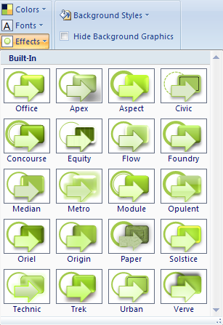
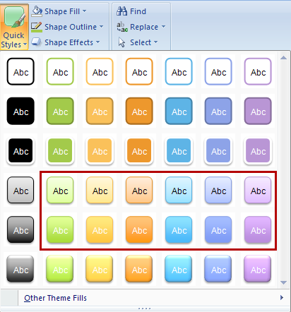
Shapes for Diagrams
Quick Style:
Subtle Effect
Quick Style:
Moderate Effect
ArcGIS
ArcGIS
DON’T APPLY EFFECTS
from the Design tab
ArcGIS
ArcGIS
ArcGIS
ArcGIS
ArcGIS
ArcGIS
ArcGIS
ArcGIS
ArcGIS
ArcGIS

